Slide 1
PROXYLESSNAS
DARTS
Differentiable Architecture Search
Notes:
Hello Everybody
Today we are gonna be talking about two Neural Architecture Search Algorithms , DARTS and ProxylessNAS.
Presented by Adam, Pawan and Me.
https://youtu.be/UJN5FMJUeMc

Slide 2
INTRODUCTION
Neural networks are complicated systems and require a lot of tuning to work properly on certain tasks such as image classification or text classification.
NAS – Neural Network Architecture Search, are algorithmic solutions to automate the manual process of architecture design.
Reinforcement learning has been the most popular for the task but is computationally expensive requiring on the order of thousands of GPU hours to find a suitable setup.
The two papers examined in this work, DARTS and ProxylessNAS, propose techniques to create a continuous loss function that includes a representation of the network architecture so that gradient descent can be used to find an optimal architecture in much less time.
Since, both the papers are attempting to find the optimal Neural Network Architecture for CNN’s (DARTS and Proxyless) and RNN’s (DARTS Only). Hence, it would help to briefly overview the functioning of these two varying Neural Networks.
Notes:
So Neural networks are quiet complicated system having a lot of parameters like layers and weights.
Till now we use to come up with an efficient neural network by using our sheer brain power but then we realized that by automating it we can achieve a more efficient neural network.
This automation is achieved by doing a Neural Architecture Search.
In the past we used to do this by doing Reinforcement Learning, but it turned out to be very expensive computationally.
The two papers examined in this work, Darts and ProxylessNas, propose techniques to create a continuous loss function and then use gradient descent to find the optimal architecture
since both DARTS And ProxylessNAS work on CNN and RNN we would breifly discuss those

Slide 3
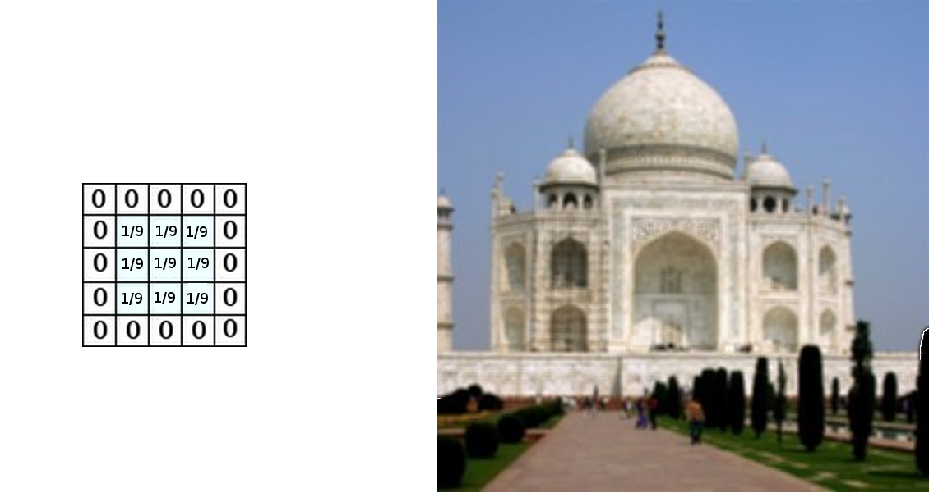
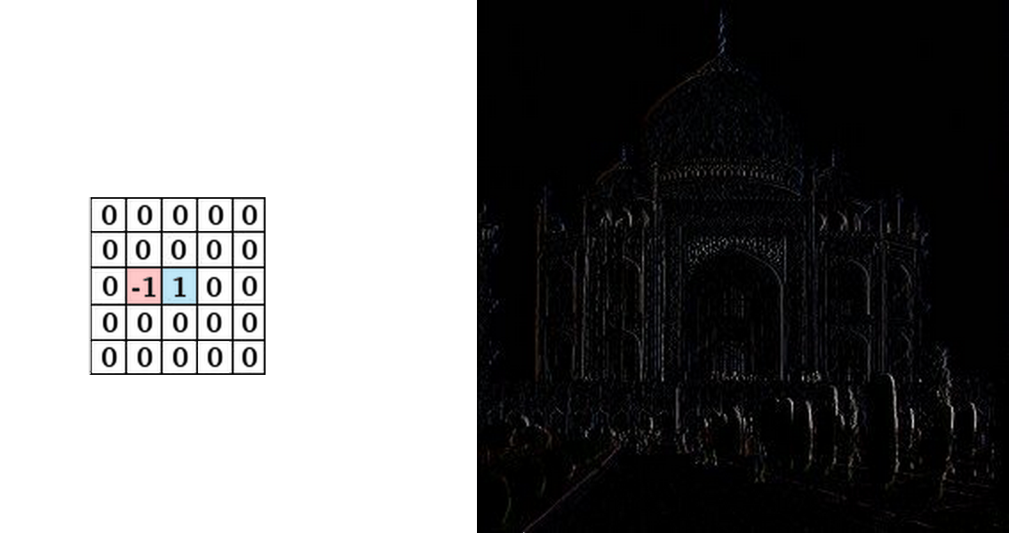
CNN: CONVOLUTIONAL NEURAL NETWORKS
A Convolutional Neural Network (CNN, or ConvNet) is a class of deep neural networks, most commonly used to analyze visual imagery. They usually consist of multiple hidden layers.
Convolutional Layers
Emulates a single neuron. Basically, an N x N Matrix that are used as a feature detector. Output is a feature map which is a representation of the image.
RELU Layers
Used to introduce nonlinearity to a system that has been computing linear operations in the previous layers.
Pooling Layers
Used to reduce the dimensions of the data by combining output of region in a feature layer together. The combination is done by calculating the average of the previous activations, or taking their averages
Fully Connected Layers
Same as the traditional multi-layer perceptron neural network (MLP). The flattened matrix goes through a fully connected layer to classify the images.
Notes:
A CNN is a class of deep neural networks which are most commonly used to analyze images.
They consist of multiple hidden layers
The CONVOLUTIONAL LAYER basically uses a small NXN matrix as a filter which helps in detecting features
The Rectified Linear Unit is a layer which introduces nonlinearity to a system that has been computing linear operations in the previous layers.
POOLING LAYERS are used to reduce the dimenSion of the data by passing it through a NxN window and choosing the max value in it.
FULLY CONNECTED LAYER basically flattens the matrix by using all the previous layers and then give us the classified output

Slide 4
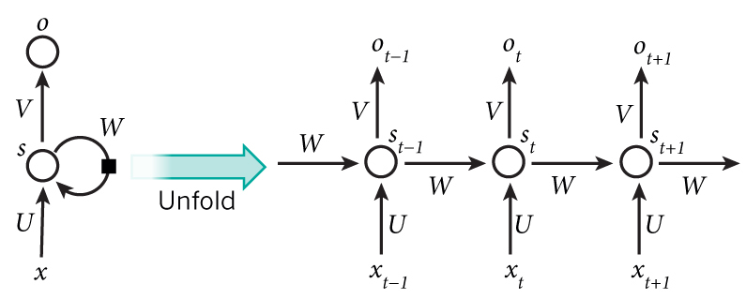
RNN: RECURRENT NEURAL NETWORKS
Recurrent Neural Network (RNN are widely used for language modeling.
It captures information about what has been calculated so far.
We can think of RNNs as multiple copies of the same network, each passing a message to a successor in a sequence.
Each element performs the same task with the output being dependent on the previous element’s computation.
The input to the hidden node in an RNN is both the input at the current timestep, and the value of its own activation in the previous timestep.
Notes:
Recurrent Neural Network are widely used in language modeling.
We can think of RNNs as multiple copies of the same network, each passing a message to the successor in the sequence and the successor using that as memory in it’s computation

Slide 5
DARTS (DIFFERENTIABLE ARCHITECTURE SEARCH)
Existing state of the art NAS Algorithms
The existing architecture search algorithms are computationally demanding.
The search is treated as a black-box optimization problem over a discrete domain.
A large number of architecture evaluations are required to find the most efficient architecture.
DARTS
DARTS uses a continuous search space.
It performs gradient descent based on the the Validation set performance to optimize the Architecture.
Does not fine-tune specific aspects of the architecture, but instead learns the entire architecture building block.
Simpler than many existing NAS approaches and can handle both CNNs and RNNs.
Notes:
use reinforcement learning (RL) or evolution
Large number of architecture evaluations are required due to the discrete
The operation types are discrete and so are the number of nodes, so representing it in a continuous way is more difficult.
Searches for a computation cell as the building block of the final architecture. The learned cell could either be stacked to form a CNN or recursively connected to form an RNN.

Slide 6
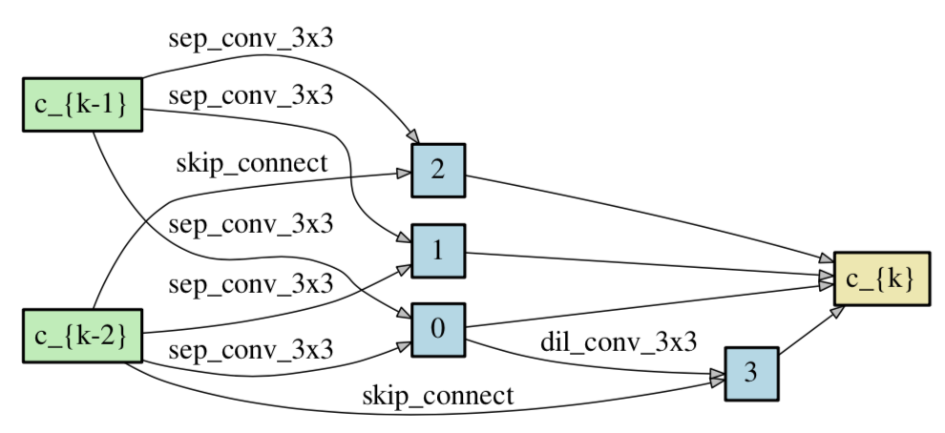
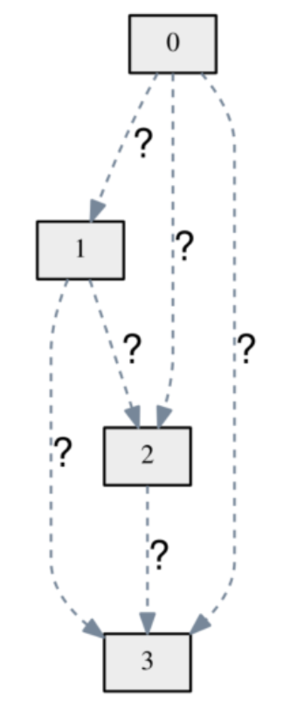
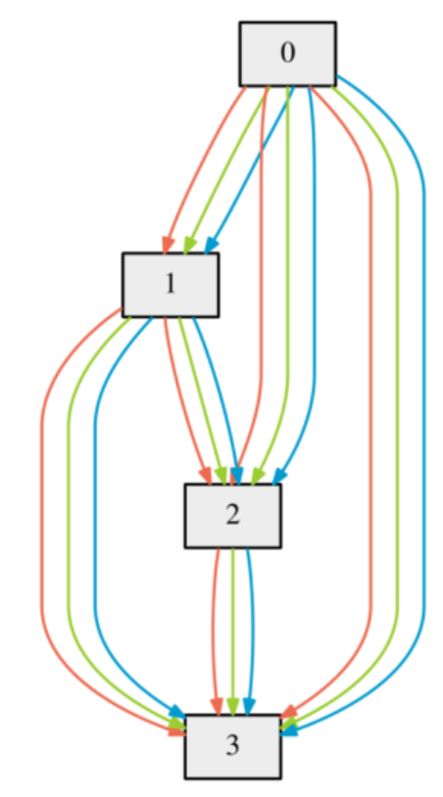
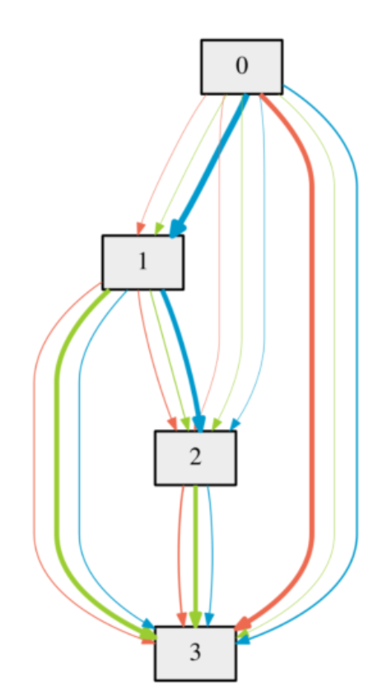
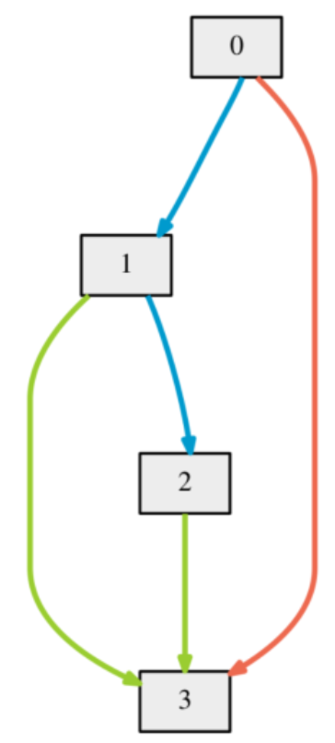
DARTS - Cell
A cell is a directed acyclic graph with N nodes.
A node is the output of an operation (like a feature map)
The edges are the operations (like convolution, max pooling, zero, ReLU) themselves.
It optimizes:
The weights for the architecture to reduce the training loss on that network.
The architecture, which is evaluated by taking the validation loss of the network with the current architecture using the weights that it optimized already.
Overview of DARTS (General Cell Structure)
Example of a learned cell on CIFAR-10
Notes:
It uses joint optimization to obtain the mixing probabilities for the architecture and the network weights.
Operations on all the edges are initially unknown.
The search space is continuously relaxed by placing a mixture of candidate operations on each edge.
The mixing probabilities and the networks weights are obtained by performing a bilevel optimization on both the architecture and the weights
The final architecture is induced from the learned mixing probabilities.

Slide 7
DARTS
The experiments consist of two stages,
Architecture search: Cell Architectures are searched and the best one are selected
Architecture evaluation: Best cells are selected and used to construct larger architectures.
Transferability is also tested on Large Datasets, such as ImageNet and WikiText-2 (WT2).
Once the architectures are selected, the architectures are initialized with random weights, trained from scratch and results are reported based on the performance on the test set.
The best cells from the selected architectures are evaluated on ImageNet (mobile setting) and WikiText-2, by stacking them on top of each other.
Notes:
Cell architectures are searched for using DARTS, and the best ones are chosen based on their performance on the validation set.
Best performing cells are used as building blocks to construct larger architectures, which are used to train on the test set.
Transferability is also tested using the best cells from the tests on CIFAR-10 and PTB, on ImageNet and WikiText-2 (WT2) respectively.
The architectures chosen for evaluation are based on running DARTS four times with random seed values and then the best cells are picked based on their validation set performance training for a really short period of time (100 epochs on CIFAR-10 and 300 epochs on PTB). This is important as the optimization techniques could give varying results based on the initialization parameters.
Really Expensive to calculate the architecture gradient for each inner optimization. Therefore, a simple technique to approximate the training loss by adapting w using only a single training step, without solving the inner optimization

Slide 8
APPLICATIONS
DARTS
Results
DARTs was able to provide the lowest error rates on CIFAR-10 and text perplexity on PTB respectively, when compared to other state of the art NAS Algorithms.
DARTS requires the least number of parameters and the lowest number of GPU days compared to other State of the art NAS Algorithms.
On CIFAR-10, DARTS required three order of magnitude less computation resources to achieve comparable results to other state of the art architectures (that is 1.5 or 4 GPU days vs 2000 GPU days for NASNet and 3150 GPU days for AmoebaNet) and with a slightly longer search time, DARTS outperformed ENAS by discovering cells with comparable error rates but less parameters.
Experiments with the cell learned on CIFAR-10 can be transferred to ImageNet. Cells discovered by DARTS also transfers to WikiText2 better than the ones discovered by ENAS.
Look in the slide notes below for topics to consider talking about
AmoebaNet, NASNet and ENAS are all state-of-the-art Neural Network Architecture Search Algorithms
Notes:
Here Text Perplexity is a measurement of how well a probability distribution or probability model predicts a sample.
It is used to compare NLP models.
A low perplexity indicates the model is good at predicting the sample.

Slide 9
PROXYLESSNAS
DARTS requires a lot of memory
Similar architecture representation to DARTS
Trains for specific target hardware
Over-parameterized network instead of stackable cells
To reduce training complexity, the paths weights are binarized so that only one is used at a time
Notes:
DARTS. requires a large amount of memory to store all the nodes in a network (architecture), their weights and the outputs. For N paths through the network representation it need N times the amount of GPU memory to train the network compared to a regular CNN. The solution was to search for small components of the network, called blocks, and put them together to form a larger network.
ProxylessNAS uses a similar technique for representing the architecture. A set of nodes, that make up the network and model connections, are created.
A network much larger than DARTs is created, containing all the candidate operations connecting each of the nodes together. This over-parameterized network is too large to train on using DARTS.
Instead of using all the paths in the network at once, the paths weights are binarized so that only one is used at a time.
In the network representation there are weights on all the paths that connect the nodes together. If the path weight is low, that means the connection is unlikely to be useful. If the path weight is high, then it should be a part of the final architecture.
ProxylessNAS came out 6 months after DARTS

Slide 10
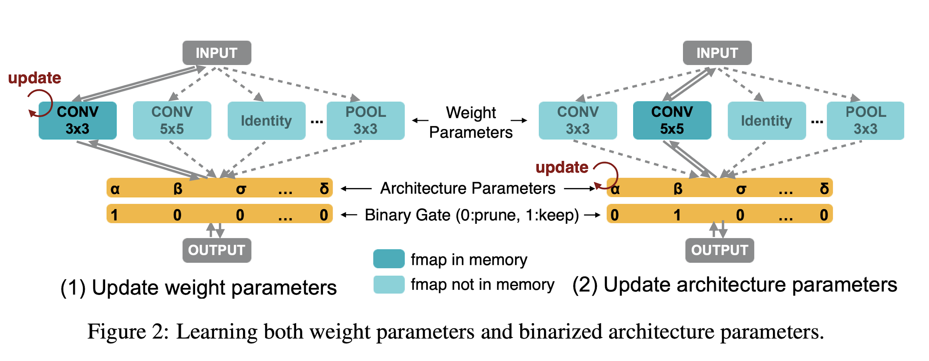
PROXYLESSNAS
Search Technique
Freezing weights while training one set of parameters reduces memory
Notes:
First select a random path through the network by sampling from the path weight distribution
Then ignore all of the other paths, their feature maps are not necessary to calculate the loss for the selected path
Calculate the loss on the training data to update the network weights
Update the network weights
Calculate the loss on the validation data for the architecture
Update the architecture
Each batch of input data is passed through the model, a new path is randomly selected through the network using the path weights as the distribution to sample from. Then the weight parameters on the currently selected path are updated. So as a batch of image data is passed through the network, the weights of the convolution kernels would be updated.
During this part of the training, the architecture parameters remain constant. Then using this path, the loss is calculated on the validation set and the gradient with respect to the architecture parameters is calculated, while the weights of the selected path are kept constant.
With the gradient computed, the architecture parameters can be updated so now a different path may have higher weights. Freezing one set of weights when training on the other, for example freezing architecture weights when training the network, also helps reduce memory consumption.

Slide 11
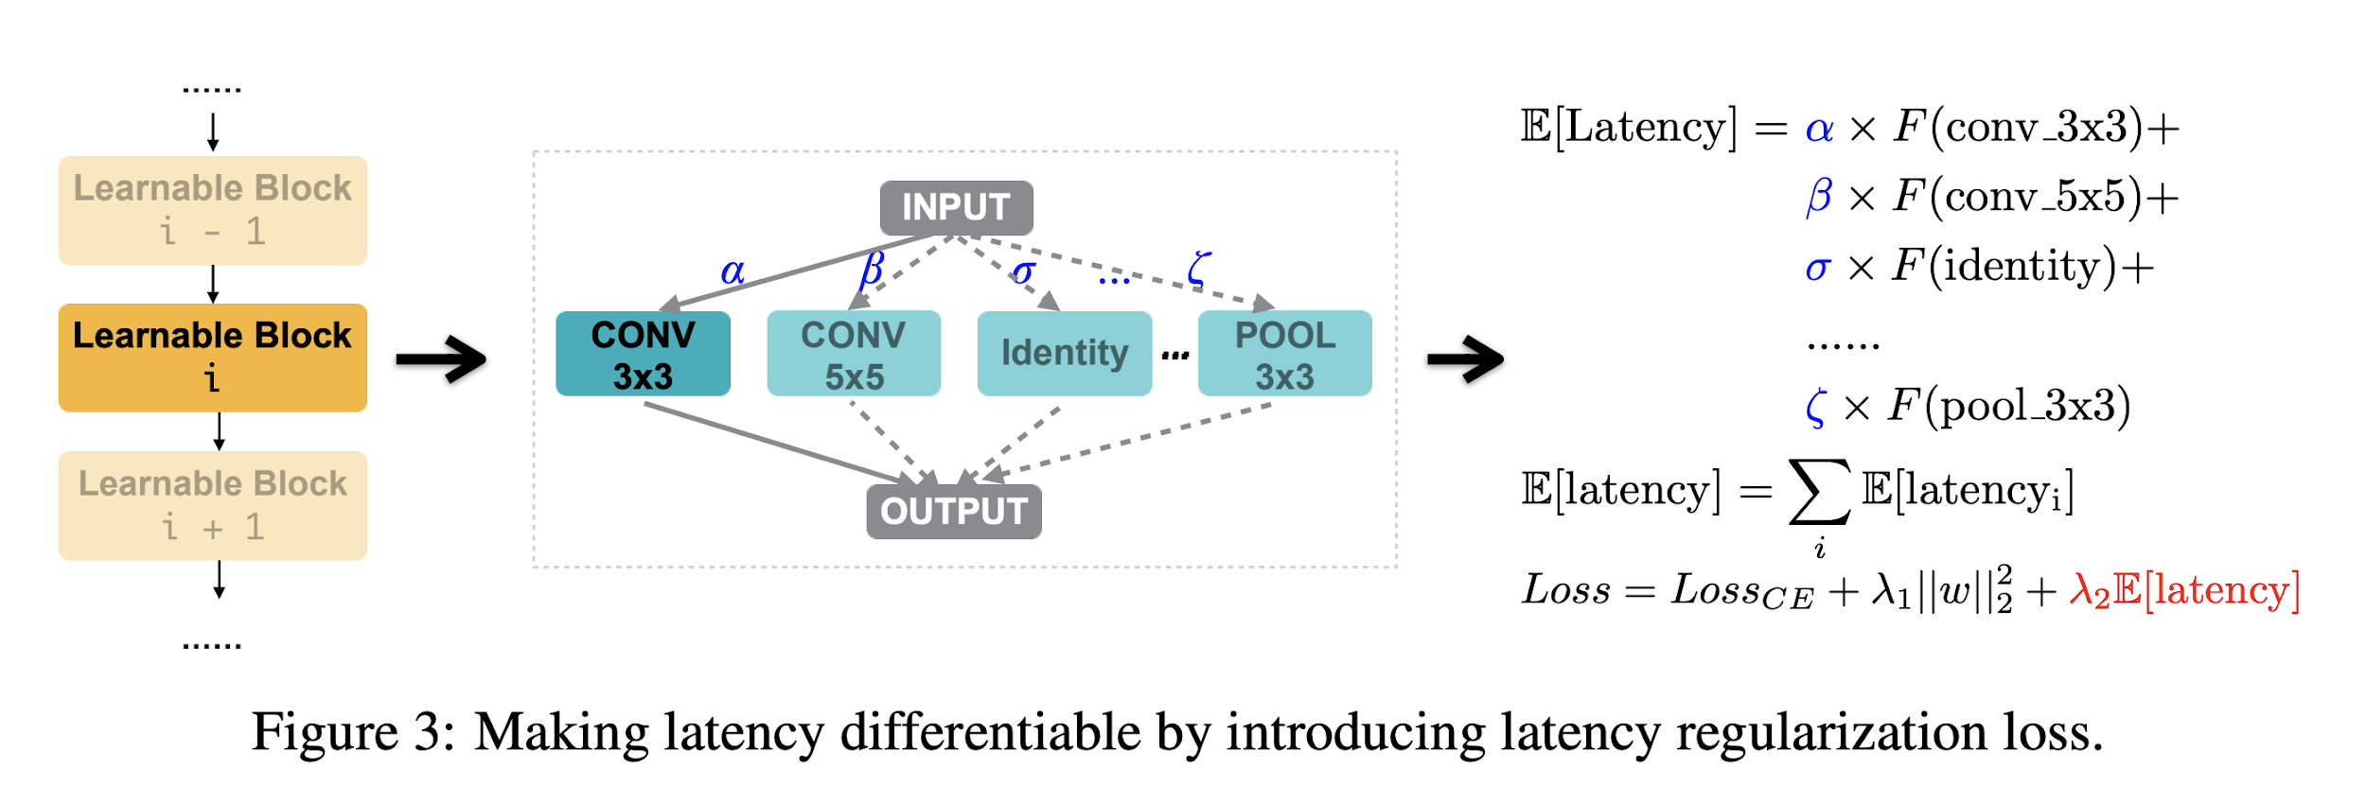
PROXYLESSNAS
Training for specific hardware
Latency vs. FLOPs
Regularizing by weights keeps them from getting out of control
Notes:
To train the architecture for different hardware the overall latency, which is the time it takes for a given architecture to predict a result for an input, of the network needed to be reduced. Latency was used instead of FLOPs because GPUs can run operations in parallel so FLOPs would not be a good indication of response time on that platform.
Latency was modelled as a continuous function of an operation, such as conv 3x3 or max pooling. The latency function can be changed depending on the target hardware.
The total latency for the network is the latency of each operation in the over-parameterized network weighted by its probability of ending up in the final architecture. The overall latency is a function of the architecture so the gradient of this function with respect to the architecture can be computed to reduce latency. The latency of the architecture is added to the overall loss function.
Large network weights can be a sign of an unstable network, where even small changes in the input can lead to large changes in the output. It is also a sign that the network is overfitting the training dataset which can lead to poor performance on test data. To avoid such an issue, a weight regularization term is added to the loss function.
The weight regularization and the latency term are multiplied by scale factors which are hyperparameters so the sensitivity of the loss function to the weights and latency can be adjusted.

Slide 12
PROXYLESSNAS
Results
CIFAR-10 2.08% error compared to 2.13% by AmoebaNet-B but uses only 5.7M parameters to 34.9M
ImageNet GPU 75.1% accuracy compared to 72%
ImageNet mobile when evaluations must be under 80ms, it ran in 78ms and was 74.6% accurate.
Without latency regularization, the architecture search finds one with 158ms of latency on the Pixel 1, so it is necessary to explicitly train for it.
Less computationally expensive, 200 GPU hours while next best is 40,000
Notes:
ProxylessNAS was able to achieve state-of-the-art results in a few different categories.
On CIFAR-10 it got 2.08% test error compared to the 2.13% achieved by AmoebaNet-B, a marginal improvement, but uses only 5.7 million parameters while AmoebaNet-B uses 34.9 million.
On ImageNet evaluated on a GPU, it also achieved state-of-the-art accuracy, getting 75.1% while the previous best was 72%. When testing ImageNet on a mobile platform it achieved state-of-the-art accuracy when evaluations must be under 80ms, it ran in 78ms and was 74.6% accurate.
Without latency regularization, the architecture search finds one with 158ms of latency on the Pixel 1, so it is necessary to explicitly train for it.
Search cost is also much lower than the other methods. It takes 200 GPU hours to search for an architecture while the next best is 40,000 GPU hours.

Slide 13
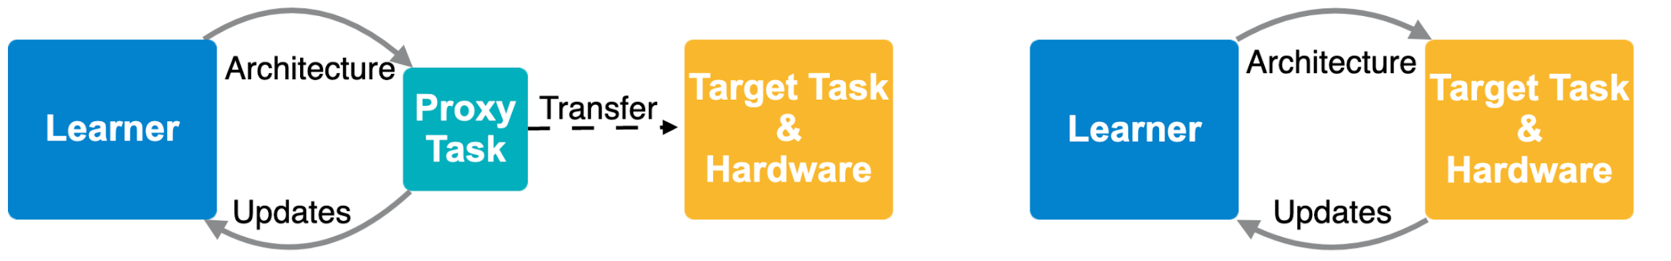
DARTS PROXYLESSNAS
Differentiable architecture search is much faster than previous techniques, but it requires a lot of GPU memory.
DARTS train the architecture on a smaller, proxy, task like a subset of CIFAR-10.
The trained architecture is then used on the true target task such as ImageNet.
Architecture is not tailored to the true task that it was meant to solve so it is unlikely to be the best architecture for the job.
ProxylessNAS learns different architectures for different target hardware and target task.
ProxylessNAS trains the architecture on the target task and hardware.
The architecture trained for a GPU can take advantage of the parallelism that the hardware provides and is tested directly on the target task.
A differentiable function to model the performance of different devices is used, so that the architecture can be learned for a specific device. So the architectures searched will be the best for the task.
Look in the slide notes below for topics to consider talking about

